Slide 1
Marketing and Retail Analytics Milestone – 1 Project
Swaathi Ramakrishnan
PGP-DSBA - May ‘22

Slide 2
Contents
Problem Statement
Agenda and Executive Summary
Exploratory Data Analysis
Customer Segmentation using RFM Analysis
KNIME Workflow Image
RFM Analysis Output
Inferences
Recommendation
Working Files

Slide 3
Problem Statement
An automobile parts manufacturing company has collected data of transactions for 3 years. They do not have any in-house data science team, hence we need to provide them with suitable insights about their data and their customers.

Slide 4
Agenda and Executive Summary
Agenda
We aim to find the underlying buying patterns of the customers of an automobile part manufacturer. It will be based on the past 3 years of a Company's transaction data and hence we will recommend customized marketing strategies for different segments of customers.
Executive Summary
Three years data of an automobile parts manufacturer is provided. Summary of this data will be detailed according to shape, information etc.

Slide 5
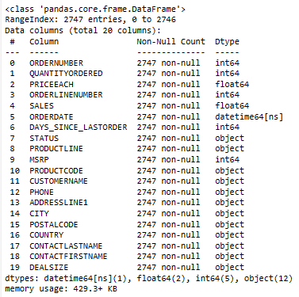
Statistics of the data
About Data and Exploratory Data Analysis (EDA)
Data Information

Slide 6
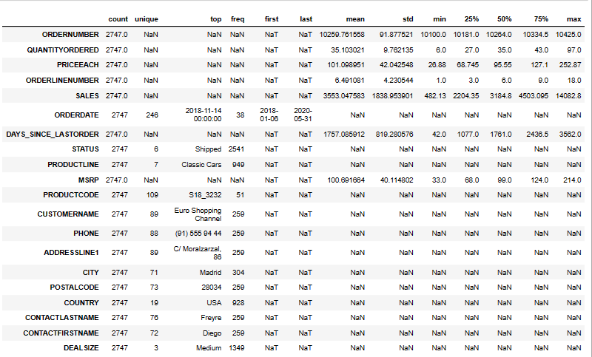
Data Description

Slide 7
Shape of the data
20 columns, 2747 rows
Nulls in data
0
Duplicates in data
0
Data Types in data
Date time: 1
Numeric: 7 (2 float and 5 integer)
Categorical/Object: 12

Slide 8
Assumptions of summary statistics
Country wise, USA has the most number of purchases, while city wise, Madrid has the most number of purchases
They have multiple product line categories like Classic Cars, Vintage Cars, Trucks and Buses, Motorcycles, Planes, Ships and Trains. Classic cars tops this list
Data has outliers in variables Sales, Quantity Ordered and Price
Medium size deals are the most
EuroShoppingChannel is the most purchased customer
We have data ranging from January 2018 to May 2020

Slide 9
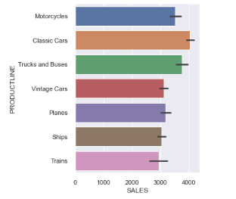
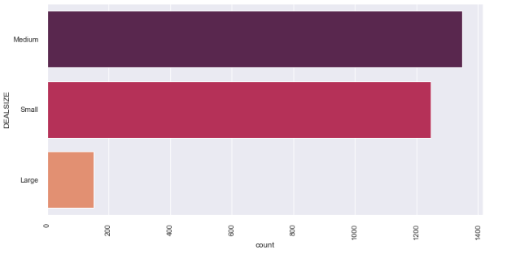
Univariate Analysis
Univariate analysis was done in python
Catplot shows the maximum purchased productline
Barplot to show the maximum deal size

Slide 10
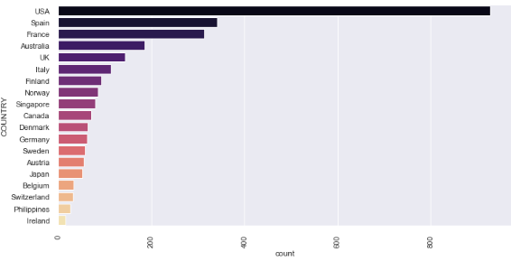
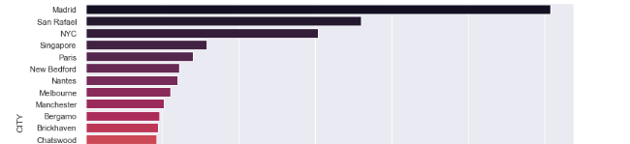
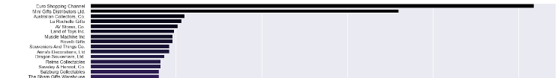
Univariate Analysis
Count Plot to show the highest purchased Country, City and Customer
USA has the highest sales, but it is across 21 cities. On the other hand, Spain has only 3 cities in which products are being bought
Euro Shopping Channel is the highest contributor among the customers present in Spain

Slide 11
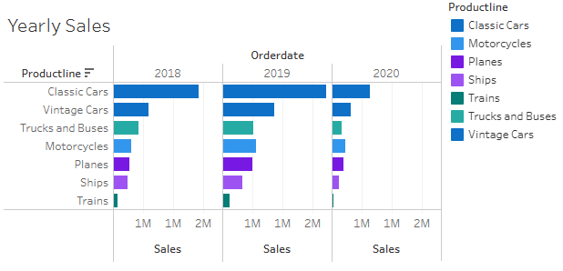
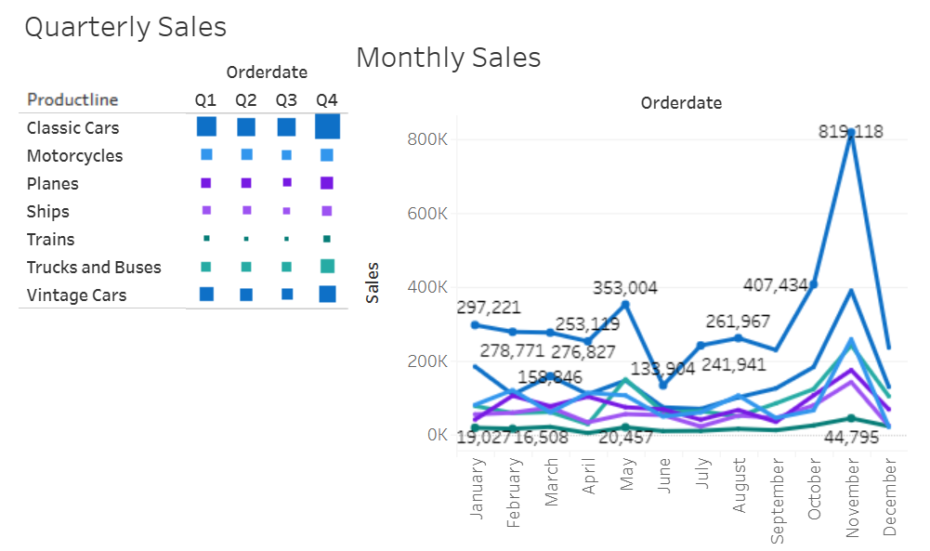
Univariate Analysis
We can see the trend in Yearly sales, Quarterly sales and Monthly sales
Classic Cars Product line generates the highest sales, rest of the product lines does not contribute as high as above.
November month has the maximum sales

Slide 12
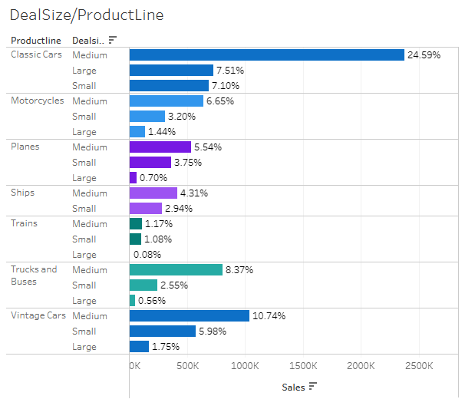
All the countries buy parts for Classic Cars product line and medium size which resonates with the highest % of total sales
Large Train parts has been ordered by only one country
Among cars, Classic cars, Trucks and buses have been purchased more rather than large vintage cars

Slide 13
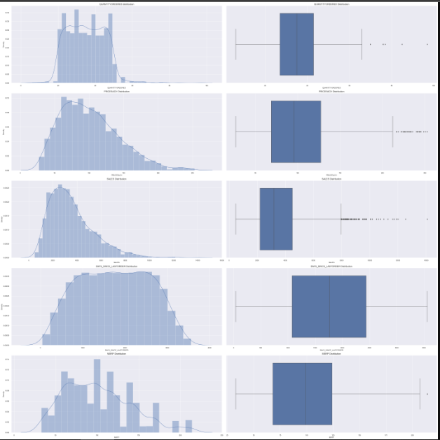
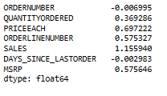
Bivariate Analysis
Box Plot and Dist Plots
Box plots show that we have outliers in the data
Dist plot shows the skew in data
SKEWNESS

Slide 14
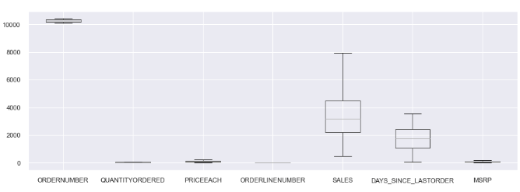
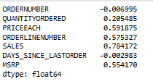
After treating outliers
SKEWNESS

Slide 15
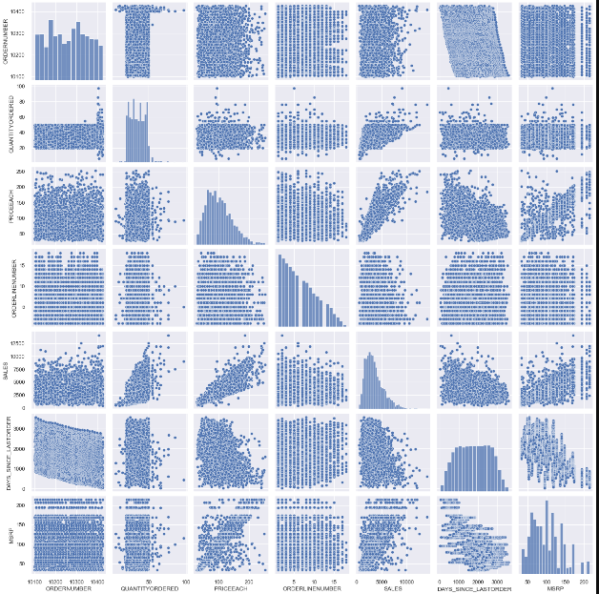
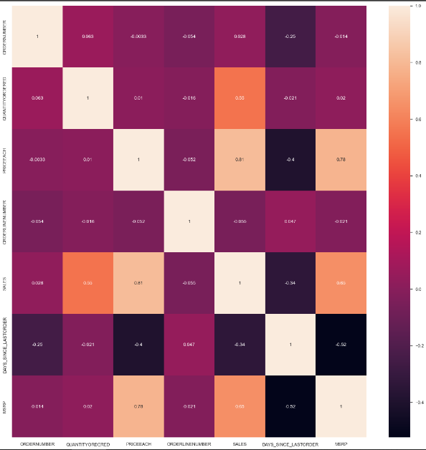
Multivariate Analysis
• Variables ‘Sales’ and ‘Price each’ have highest positive Correlation (0.81) Variables ‘Days_since_lastorder’ and ‘MSRP’ have the highest negative Correlation (-0.52). From the plot, we can see that none of the variables are symmetric.

Slide 16
Inferences from EDA
We did univariate analysi using histogram on sales variable
For categorical variable like product line using bar plot we did univariate analysis
Using boxplot on sales, product line, deal size variable, we have plotted bivariate analysis
Using MSRP, Price each, status, sales & product line variables we did multivariate analysis
After doing the analyses, we can see there is a high demand of classic cars followed by vintage cars and the least is for trains
Using tableau we have done trend analysis
The sales are high for the last quarter of the year
November month has the maximum sales

Slide 17
Customer Segmentation using RFM analysis What is RFM?
Customer Segmentation using RFM Analysis is done to divide and analyse our customers based upon their characteristics.
RFM is a marketing technique used to rank customers based on 3 metrics – Recency, Monetary and Frequency
This technique is used to identify our best / worst customers in order to undertake targeted marketing strategies
Recency – Freshness of a customer’s activity like purchase or visit
Monetary – The purchasing power or intention of the customer
Frequency – The number of times a customer visits or transacts

Slide 18
Customer Segmentation using RFM analysis Parameters used and Assumptions made
Customer Segmentation was done by using KNIME and MS Excel by dividing the data based on Recency, Frequency and Monetary variables and grouping data by variable ‘Order Number’.
Created new column name Recency as “[2020-12-31 - order date)]“. We have assumed “2020-12-31“ as a reference date and created recency column.
Based on the data, the same order number is repeated for different product codes. So we can assume count of each order number as frequency of an order number.
In SALES column we get sales amount for each transaction. We can use SALES parameter and using an assumption of sum of aggregation we created a new column as Monetary.
Created four different bins for each Recency, Frequency & Monetary using percentile range (0.0, 0.25, 0.75, 1.0). Based on above four bins assumption we have considered four segments like Loyal, Best, Lost, and customers on the verge of Churn.

Slide 19
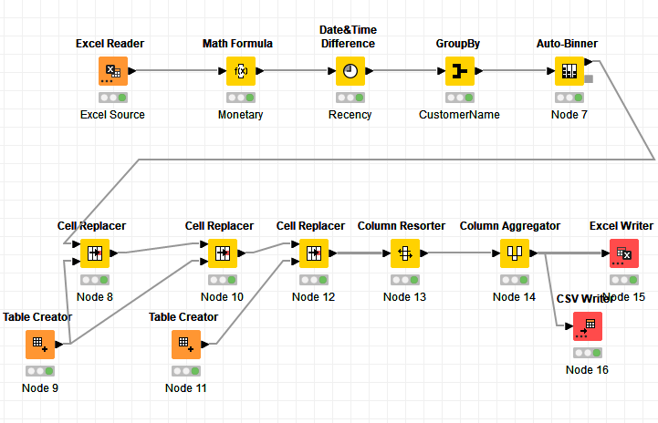
KNIME Workflow

Slide 20
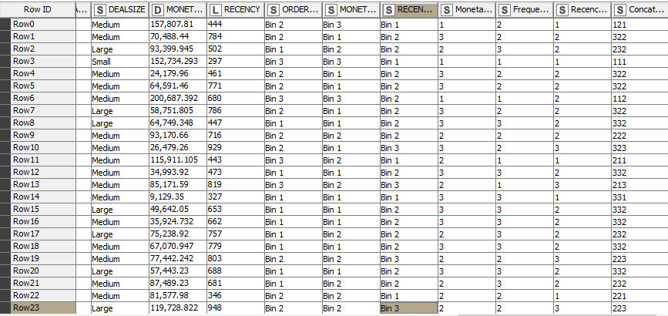
Output Table head from KNIME

Slide 21
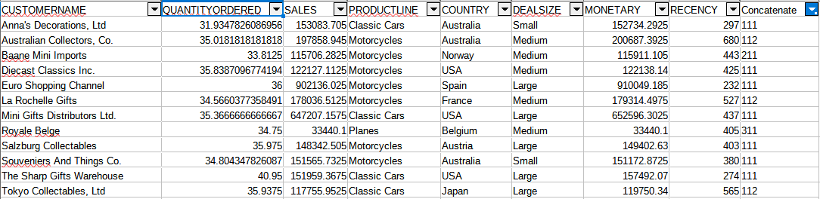
Best Customers
Based on recency, frequency & monetary, we have grouped our top customers.
We have given the most significance to recency parameter as these customers have recently purchased our products.
Also according to RFM model the most important is given to recency. Hence we have kept it as our first parameter for selecting top customers
We should not loose these customers at any cost as they are the biggest contributors of the business.

Slide 22
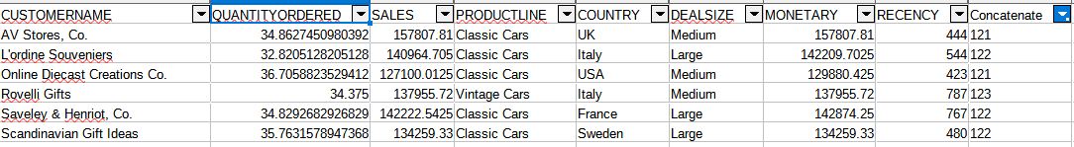
Customers on the verge of churning
These are the customers who have not ordered recently, but their monetary value is high and number of orders are more than average.
We should definitely focus on this group before we lose them and try to convert them into our regular customers

Slide 23
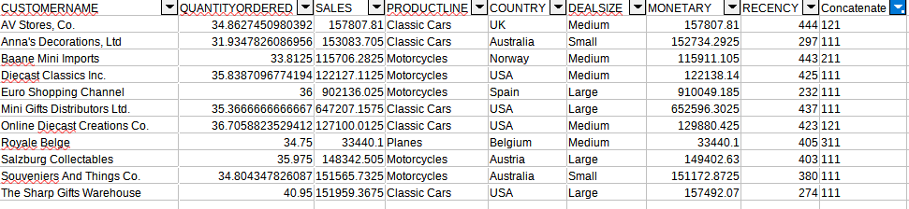
Loyal Customers
Based on recency, frequency & monetary, we have grouped our loyal customers. These customers have purchased multiple times with good monetary value.
If we focus more on this segment, we can easily turn them into our top best customers too. Also, in this segment we can see the customers for product line - classic cars are many.
These are the still valuable customers as they are with better level in all aspects Frequency and Monetary. We have to look after the needs of these customers to bring them into the best pool.

Slide 24
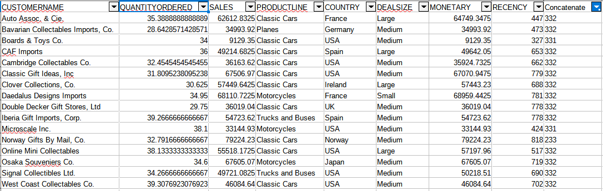
Lost Customers
Customers who did not purchase recently. They leave for a variety of reasons depending on the price deals, new product launches. Typically these are the customers who have least RFM score. Their recency is very low and they have not made any purchase since a long time. So we can say these are our lost customers.

Slide 25
Recommendations and Conclusion
Using Recency, frequency & monetary parameters we have grouped our top, loyal, on the verge of churning and lost customers. Customers with good recency has been our top customers.
Customers on verge of churning can be saved and can be converted into a good buyer.
RFM model is used for deriving the customers types like Loyal, top or best, on verge of churning & lost customers.
Recency, frequency & monetary parameters were widely used to bifurcate the types of customer's.
This model can be very helpful to the company to maintain its sales and customers and can focus on how the company has lost the customers & can take various actions to bring them back.
It is vital for the company to convert the customers who are on verge of churning into a regular customer.
In conclusion, the analysis result from the RFM is a base mapping for future response testing of customer migrations among the RFM cells. RFM scores can be analysed over time with the recommendation results. This would eliminate the non-responsive customers and improve marketing campaigns.

Slide 26
References
Jupyter Notebook SwaathiRamakrishnan_Project_MRA_EDA
KNIME Export Swaathi_Ramakrishnan_KNIME_MRA_Milestone-1.knwf
Excel_EDA Sales_Data_Final
Excel_KNIME RFM_Analysis_MRAMilestone-1_Swaathi_Ramakrishnan
Tableau Story
https://public.tableau.com/app/profile/swaathi.ramakrishnan/viz/MRA-Milestone-1-Swaathi_Ramakrishnan/Story1?publish=yes

